Slide 1
Bellwork
In your notebook, reflect on Galileo’s Abjuration, and write down one reason why you think Galileo was condemned

Slide 2
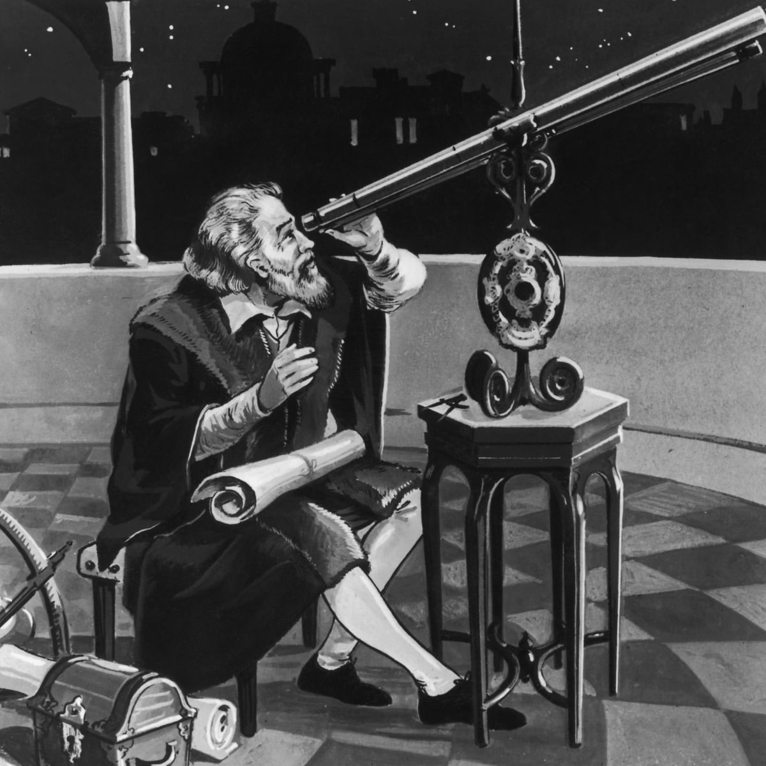
Lesson 6:
Three Models, Two Interpretations, and One Tide: The Story of Galileo’s Search for Glory
Notes:
Photo: Hulton Archive/Getty Images

Slide 3
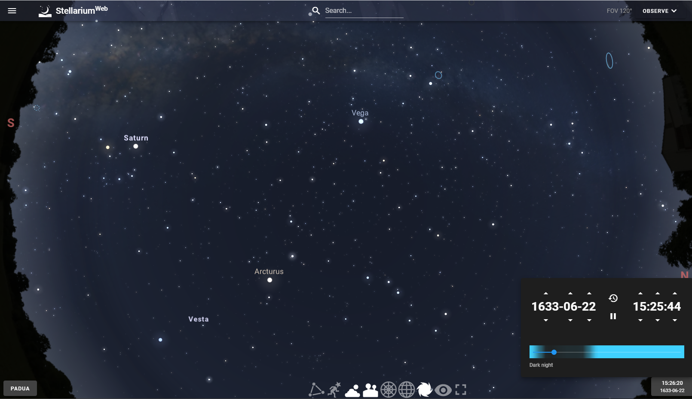
Activity #1 - 3 Models of the Universe

Slide 4
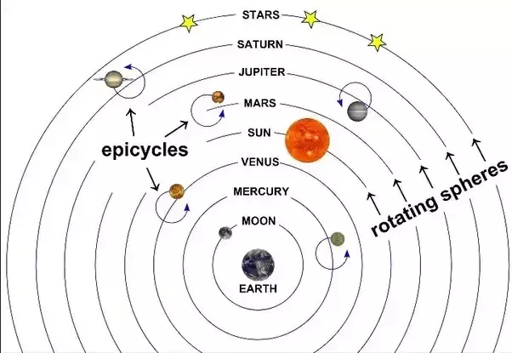
Ptolemaic Model
Notes:
http://www.faithfulscience.com/science-and-faith/brief-history-of-faithful-science.html

Slide 5
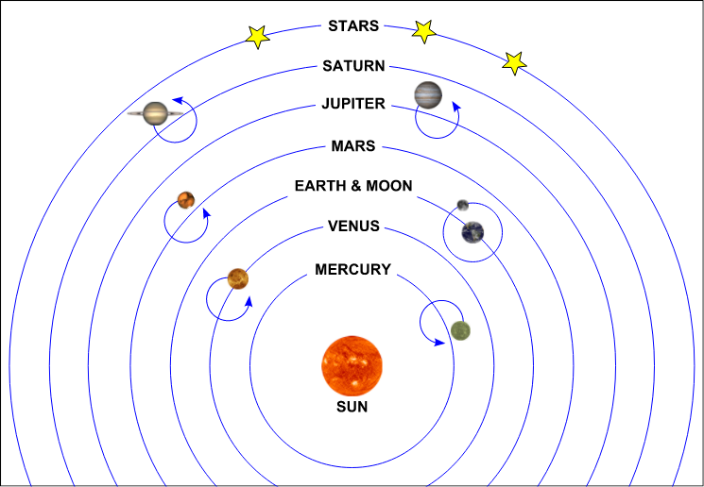
Copernican Model
Notes:
http://www.faithfulscience.com/science-and-faith/brief-history-of-faithful-science.html

Slide 6
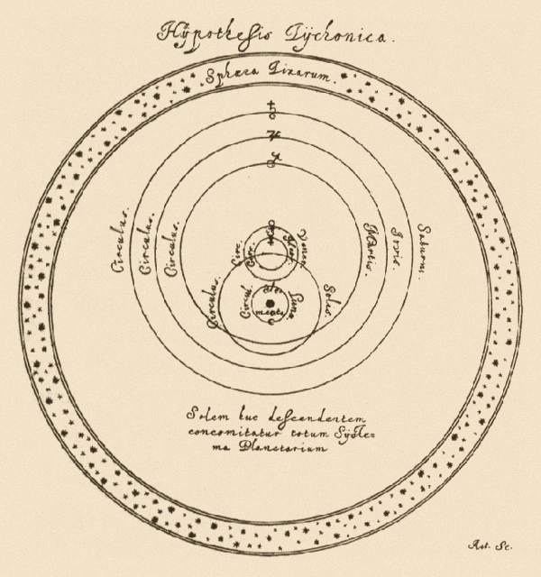
Tyconian Model
Notes:
Hevelius' Selenographia, 1647 page 163,

Slide 7
Evaluating the Models
Use the graphic organizer to determine which data are accountable within each model

Slide 8
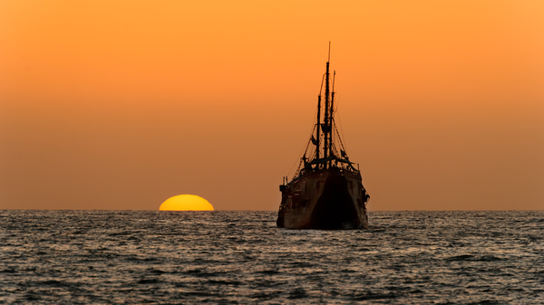
Sunrise and Sunset
Notes:
©bigstockphoto.com/mexitographer

Slide 9
Movement of the Stars, Planets, and Moon

Slide 10
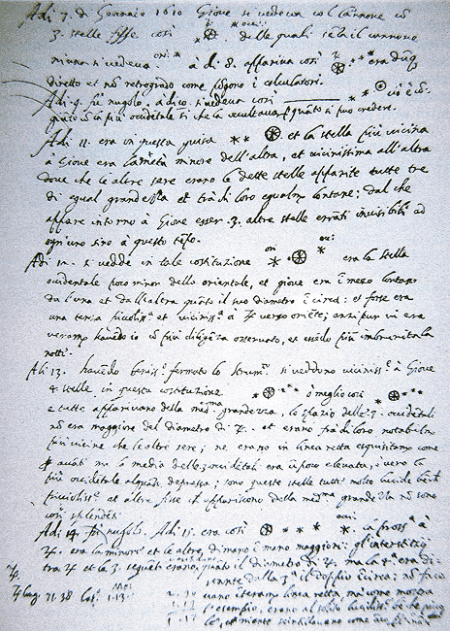
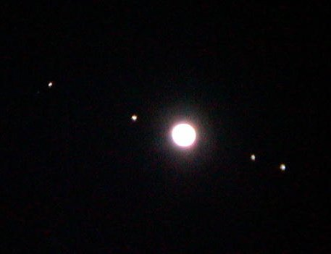
Moons of Jupiter
Notes:
http://galileo.rice.edu/images/things/journal_jup2.gif
http://astronomyonline.org/solarsystem/galileanmoons.asp

Slide 11
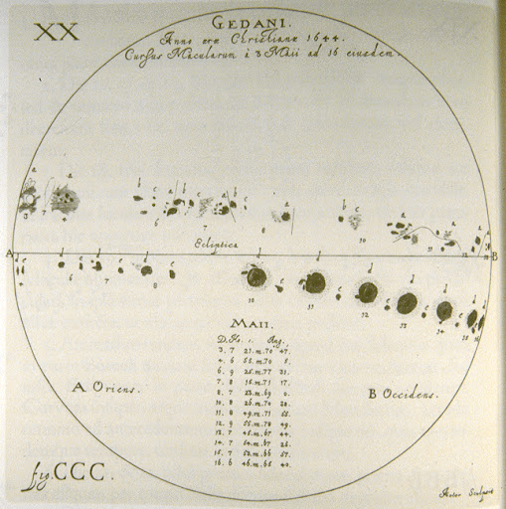
Sunspots
Notes:
http://galileo.rice.edu/sci/observations/sunspots.html

Slide 12
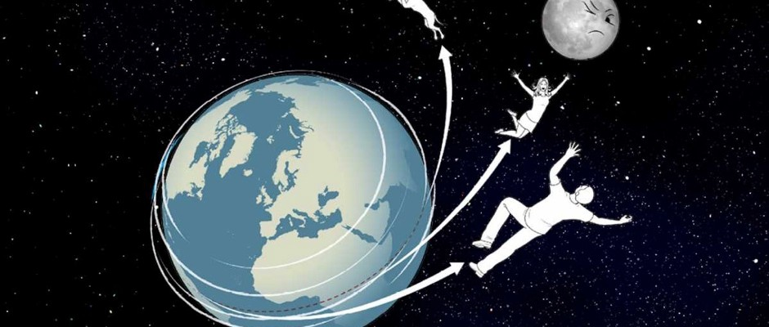
Experience of Earth’s Motion
Notes:
https://www.sciencefocus.com/space/how-fast-would-earth-need-to-spin-for-humans-to-be-thrown-into-space/

Slide 13
Homework

